Slide 1
You Lose GPT: A horror Experience
Matthew Semrau, Julianna Williams, Bryon Cobb

Slide 2
Group Objective
To entertain the user through the medium of a game, while also demonstrating a mastery of the topics covered in CS- 316 chapter 8 -13.

Slide 3
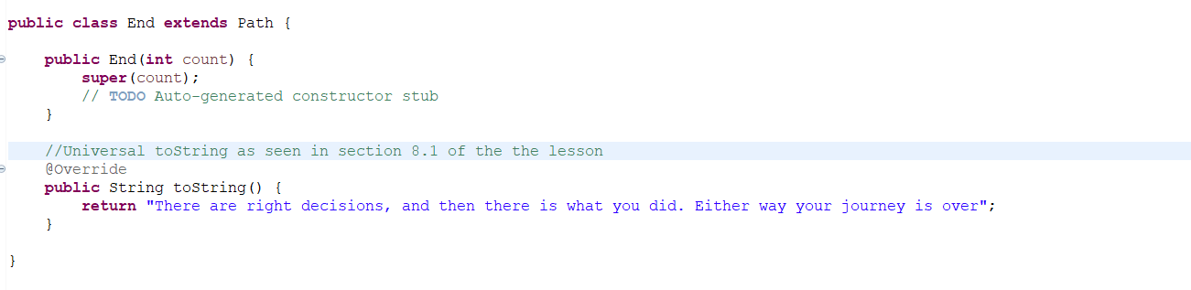
How we used Ch.8
We used the Universal toString, as seen in chapter 8 as shown below, this made sending Strings from other methods very efficient.

Slide 4
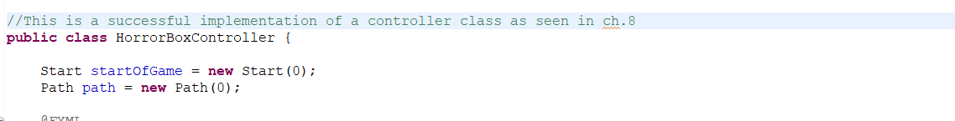
We did not directly interact with any of the html elements within the fxml file, instead relying on the controller class as shown below. This made the logic- element relationship very easy to follow.

Slide 5
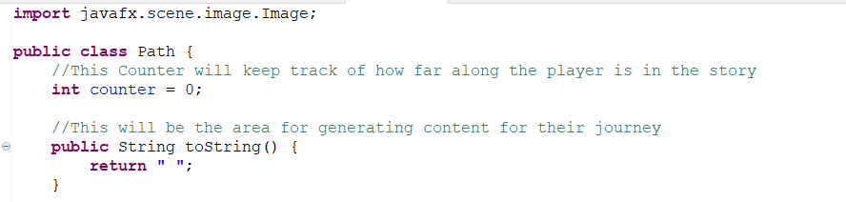
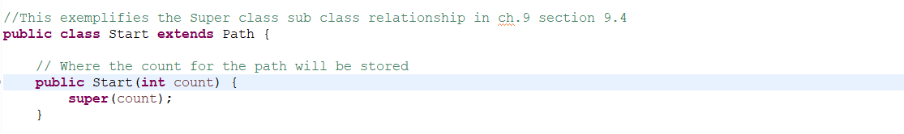
Here you see the way we implemented the chapter 9 Super Class, Sub Class relationship. Each decision a person makes is a path, this also enabled us to have a counter following a persons actions.

Slide 6
Ch.10 Object-Oriented Programming Polymorphism

Slide 7
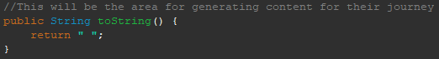
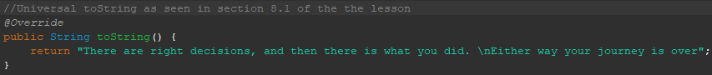
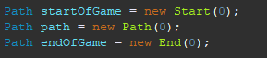
For our controller, we created different instances of our path class, and we would use override to change the toString() that we were using.

Slide 8
Ch. 11 Exception-handling

Slide 9
We currently do not have any exception-handling as we are using else-if statements to determine how far along we are in the game. Going forward, we plan on using different throw/catch statements to determine if there are any directional commands used in the user text.

Slide 10
Ch.12-13 here onward: Gui Parts 1 and 2
Chapter 12 Material Used:
12.5: Event Handling
Use of Application class, defining values for property and control, visual design within fxml, importing classes for use in the controller and normal classes, static and instance var, fx:id, FXML Loader, Action Events
12.4: use of GUI: adding and editing
Control (buttons, labels, text fields), Stage, Scenes (each story point), Layout containers (walking buttons, gridpanes), Event Handler and Controller Class
Chapter 13:
13.3: Panes and Boxes, Mouse Event Handling, Setting User Data, @fxml variables, Property Bindings and Listeners
13.5: stage.set for data-driven GUIs
All of these made the fxml file adaptable and able to change with both user input and input from the programmer. This is easier to attach data to visual elements and manipulate both the data and elements.

Slide 11






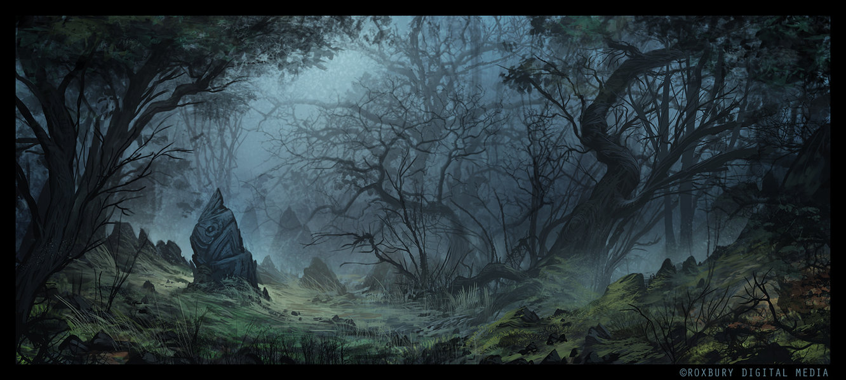

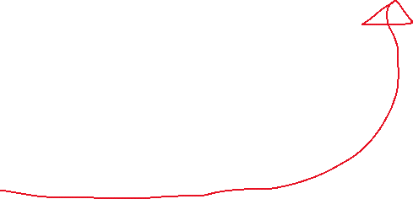



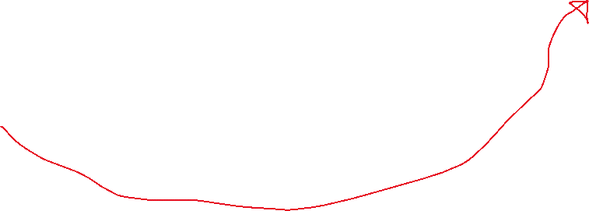


Storyline for youlosegpt
Affected the code we used to determine which image went where.
Cry
Left
Right
Straight

